Slide 1


Slide 2


Slide 3


Slide 5


Slide 6


Slide 7


Slide 8


Slide 9
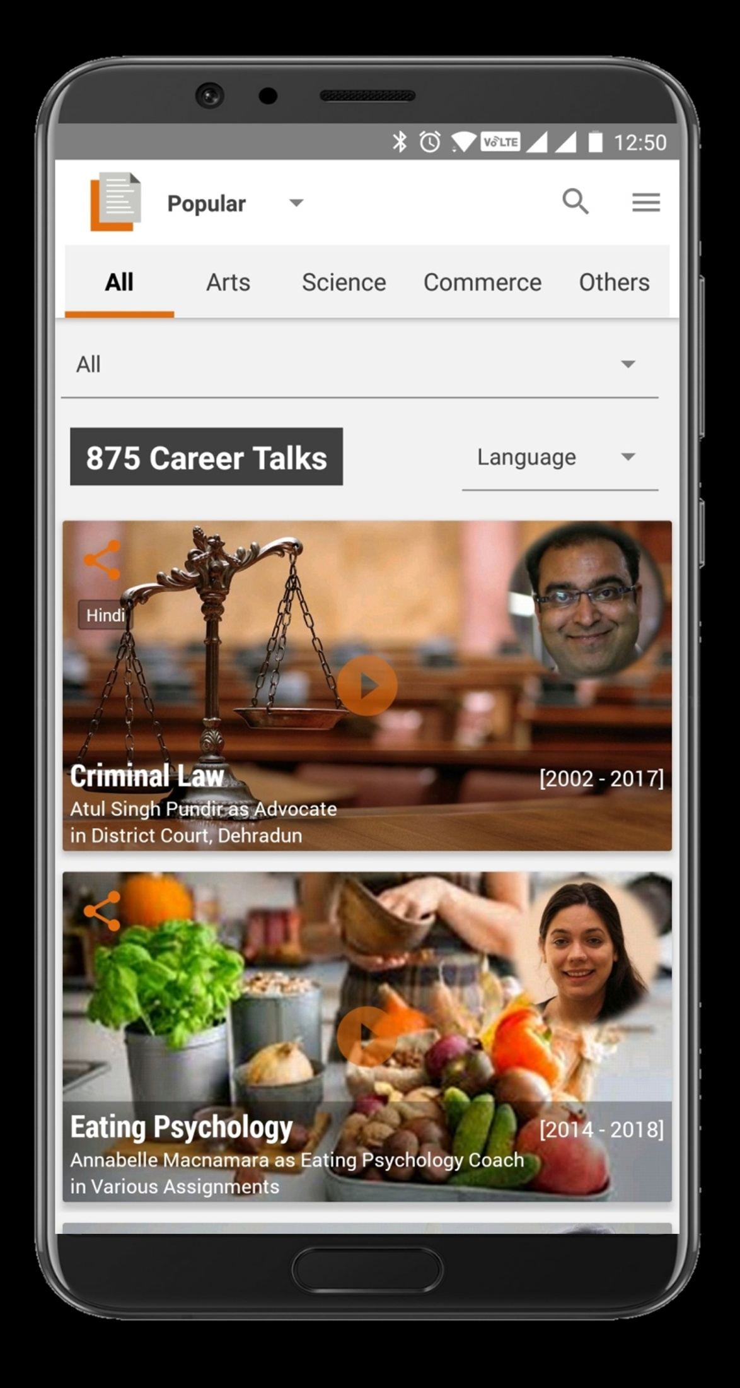
Real Professionals ... Honest Opinions

Slide 10



Slide 11


Slide 12

My Life ….. My Career ….. My Decision

Slide 13


Slide 14


Slide 15

YOUR LIFEPAGE
CAREER PLAN
www.lifepage.in/plan.php

Slide 16


Slide 17

www.lifepage.in/meet.php

Slide 18


Slide 19


Slide 20

I am best suited for?
www.lifepage.in/careerfinder.php

Slide 21

Redefining Career Services

Slide 22


Slide 23


Slide 24


Slide 25


Slide 26


